Slide 1
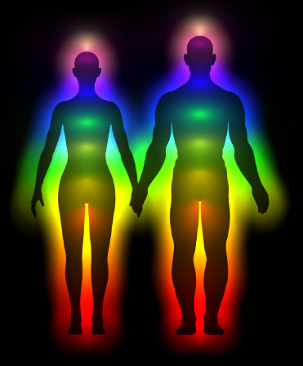

Healing & Energy
A Spiritual Teaching
Info session on the process of
SELF-HEALING
Nina
Van Calster

Slide 2
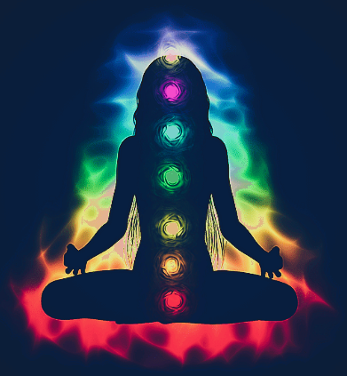
Healing & Energy
A process of Healing is always about
Self-healing
    What is the Self ?
    What is Healing?

Slide 3
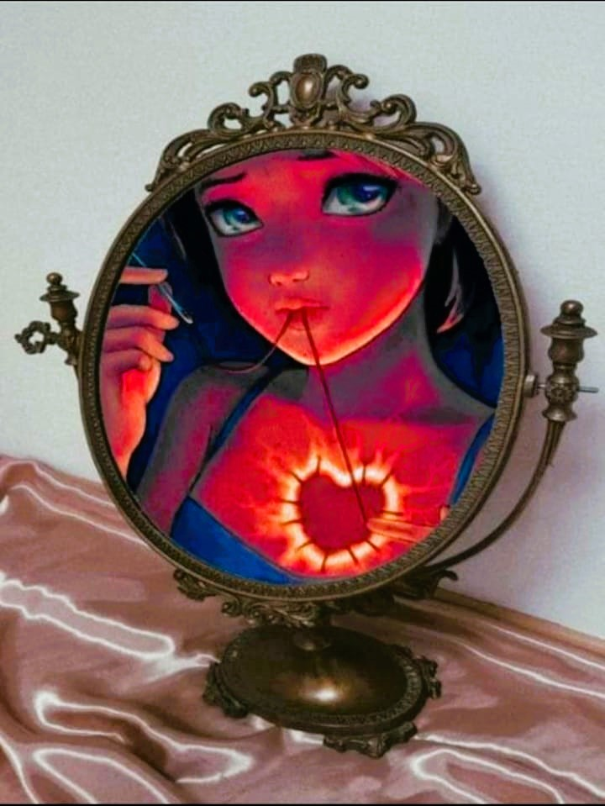
Healing & Energy
What is the Self ?
The Self are all aspects of me
What do we know?
  The aspect of me, I can see in the mirror
  → physical body, with bodily sensations
  The aspect of me, I do not see in the mirror
  → emotions – feeling ability
  → thinking – mental activity

Slide 4
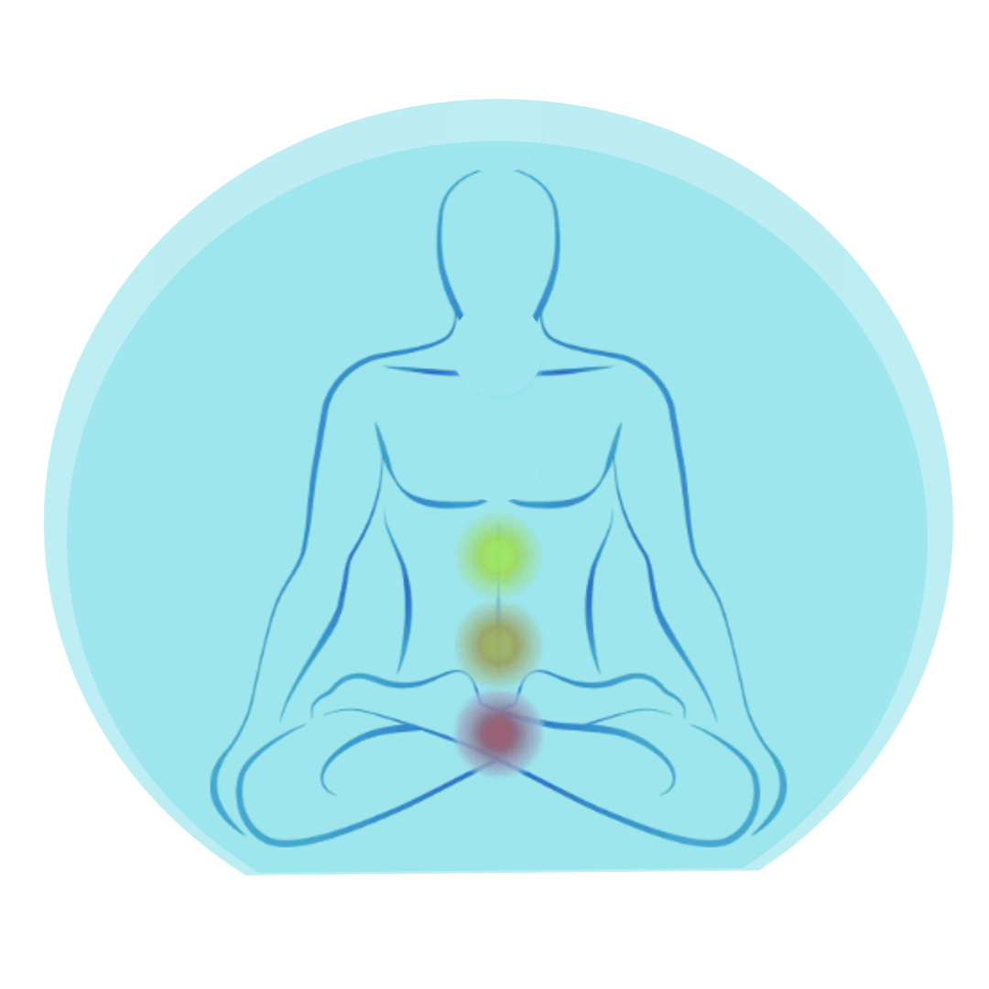
Healing & Energy
me in the energy
The lower 3 aspects
of the human being
Mental body
Emotional body
Physical body
Is there more?
Yes !

Slide 5
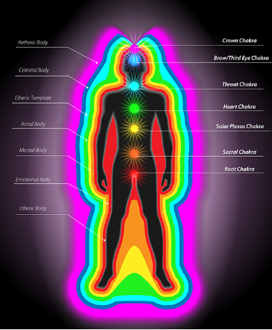

Healing & Energy
The 7 layers
of the Human Energy Field
or
The Auric Body System
7 - Ketheric body
6 - Celestial body
5 - Etheric template
4 - Astral body
3 - Mental body
2 - Emotional body
1 - Etheric body
The Human Energy Field
… and there is more !

Slide 6

Healing & Energy
• • •
Human Energy Fields in
The Universal Energy Field
Infinite omnipresent unbounded neutral
• • •
• • •
• • •
• • •

Slide 7
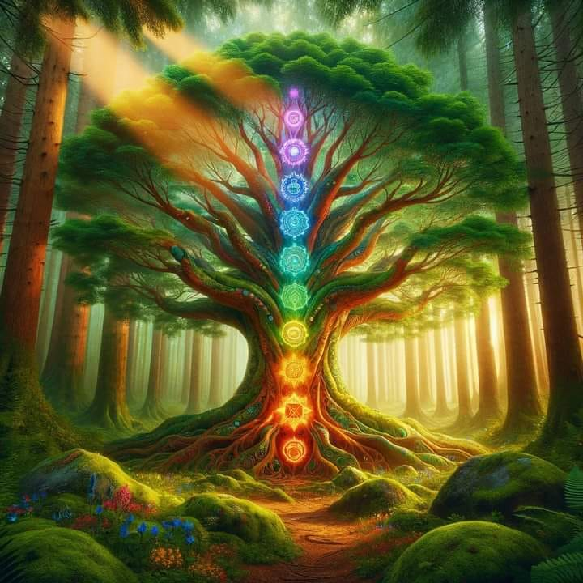
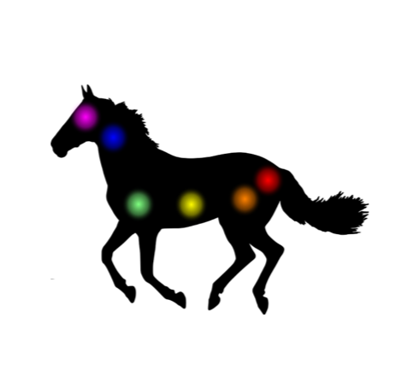
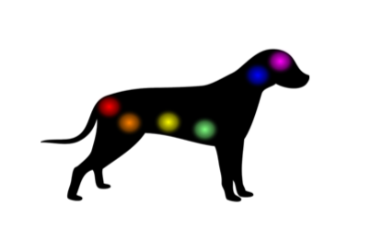

Healing & Energy
• • •
In The Universal Energy Field
We are not alone
… We are all one
  … We are interconnected
    … We influence each others Energy
• • •
• • •
Plant Energy Field
Animal Energy Field
• • •
• • •
Human Energy Field

Slide 8
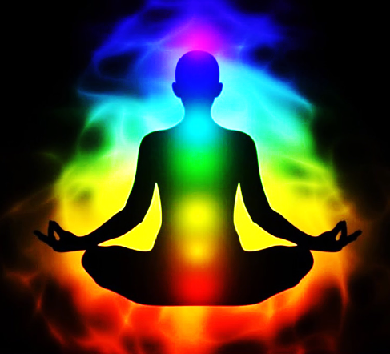
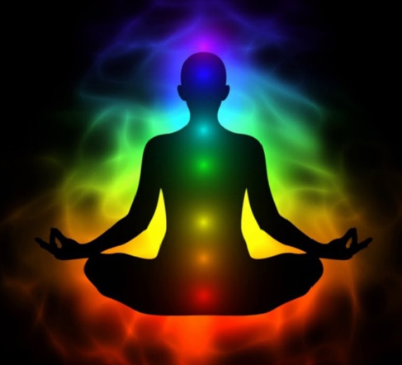
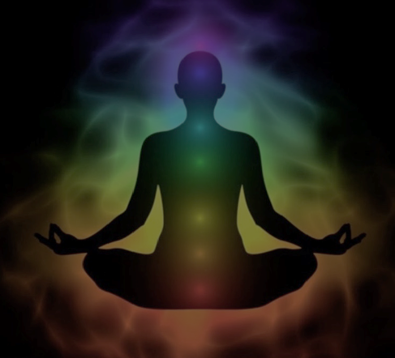
Healing & Energy
What is healing ?
  Reversing the process of illness
  Rebalancing the Energy Field
  Restoring the natural flow, in and out
In all Energy Fields, human, animal or plant
    not at ease = disease
    not in balance = imbalance
    disruption in the natural flow
Ultimately it metabolises (manifests) in visible and tangible
THE PHYSICAL BODY !
↑↓
↑↓

Slide 9
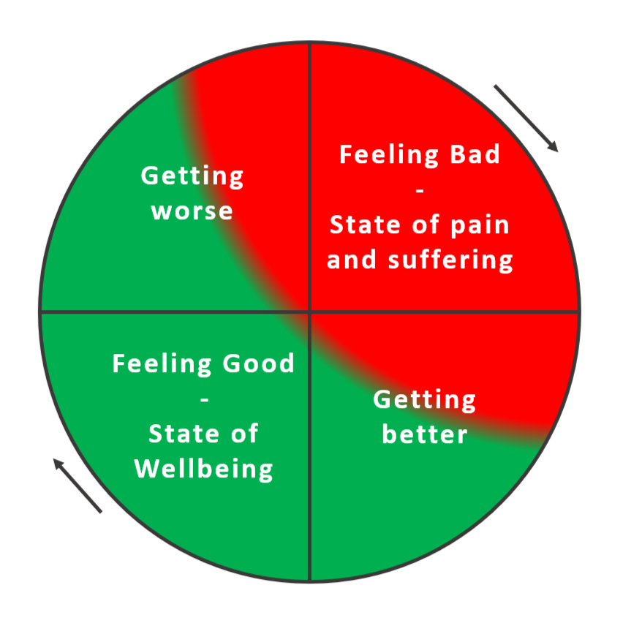
Healing & Energy
Feeling unwell, sick or ill
We seek medical attention
→ Diagnose → medication / treatment
→ we cure the physical body
The body is showing us an end result of
  a state of dis-ease
  being out of balance
  a disruption in the energy flow
A vicious circle until
↓

Slide 10
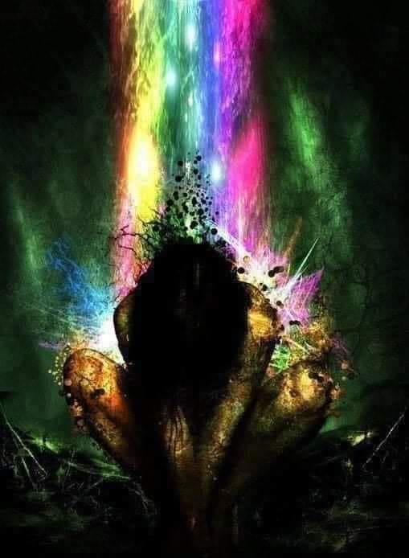
Healing & Energy
A Breaking Point
“Enough is enough” “I can’t go on like this”
Every breaking point is an Opportunity
to open up for more Awareness
It’s a Blessing !
“This cannot be it…” “Is there more?”
“How can I know?” “I want to know more!”
Ready to LEARN !

Slide 11
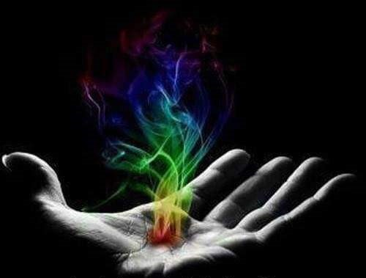
Healing & Energy
Learning
the starting point of
Healing !

Slide 12
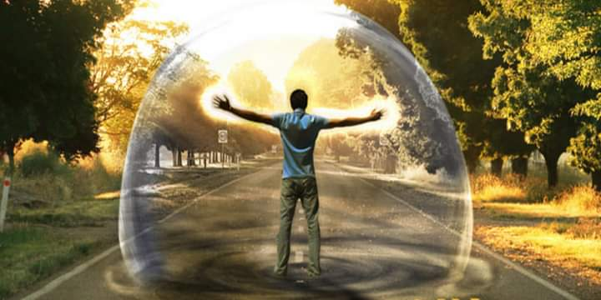
Healing & Energy
- Learning step 1 -
Acknowledging
I am more than a physical body
I am a Human Energy Field
I am Energy
I am Light
I am Consciousness
I am Awareness
I am my Soul
I am Spirit
…

Slide 13
Healing & Energy
I am a Human Energy Field
H
i
g
h
e
r
Heart-centre
L
o
w
e
r
I am my Ketheric body
I am my Celestial body
I am my Etheric template
I am my Astral body
I am my mental body
I am my emotional body
I am my physical body
I don’t have it, I am it !

Slide 14
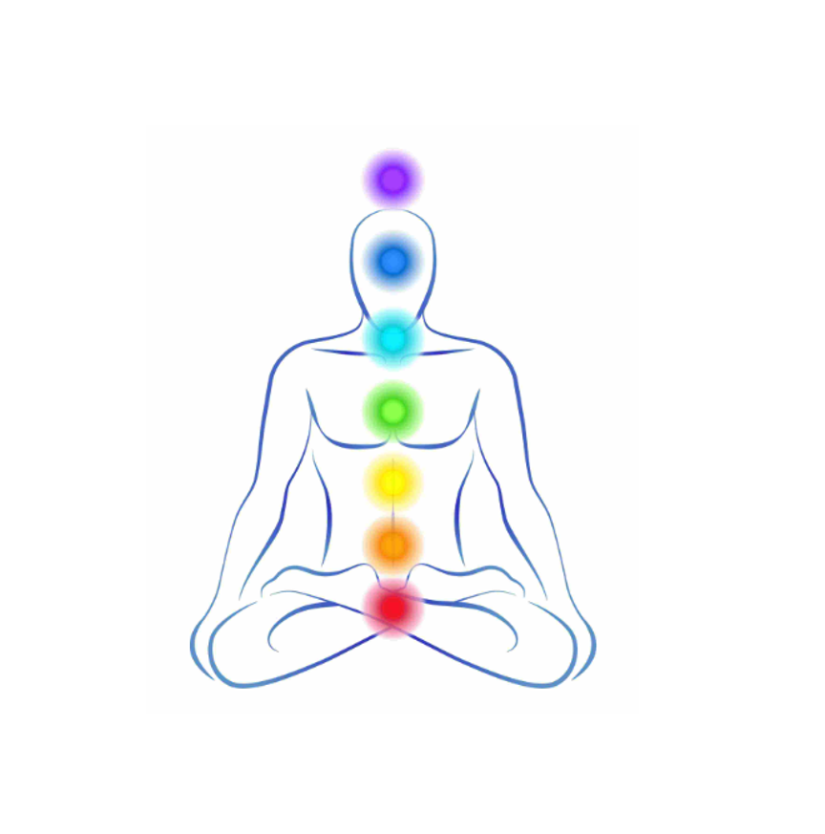
Healing & Energy
The whole of me in the energy
my HIGHER parts & my LOWER parts connected in Harmony
D O I N G
B
E
I
N
G

Slide 15




- Learning step 2 -
Accepting: I am Energy, I am a system of light that vibrates at a frequency
Healing & Energy
no top
Higher frequencies – “non-physical light”
The human “physical light”, the visible - the form
→ The spectrum of the Human experience
All humans vibrate at a frequency
Lower frequencies – “non-physical light”
no bottom

Slide 16
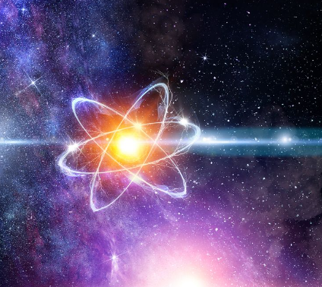
Healing & Energy
All is Energy
Human vibration and frequency
Birth → I incarnate my Energy
Growing up → I learned to perceive me as separate from others
  → 3D-thinking or Ego-human thinking
  (“Ego”, Latin word for “I”)
  → Perceiving the world through a limited use
  of the 5-senses (Touch, sight, hearing, smell and taste)
  And reacting to it

Slide 17
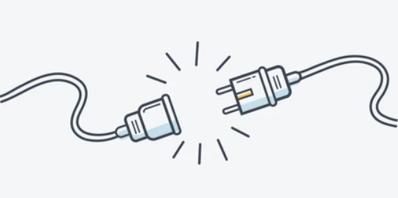
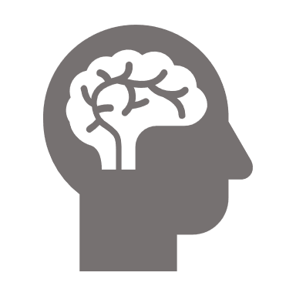










Healing & Energy
- Disconnected -
3D or Third Dimensional experience is created by the EGO-thinking human.
We define our life by reacting to all stimuli coming from the OUTER world.
We dim our own Light !
We become sick…
Mental body
Emotional body
Physical body

Slide 18


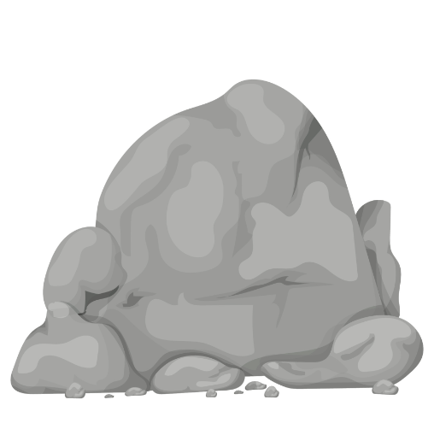
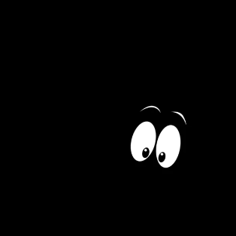
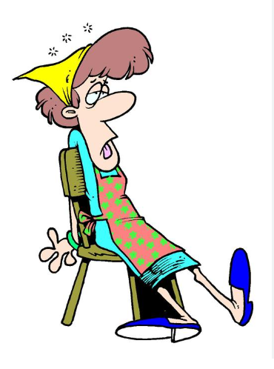
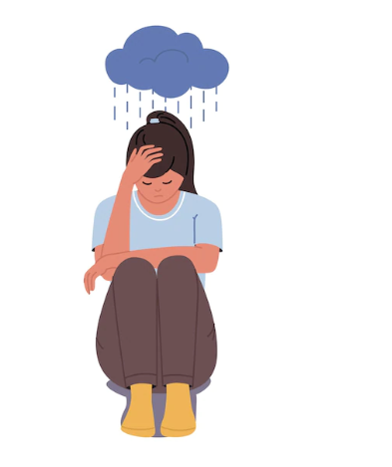
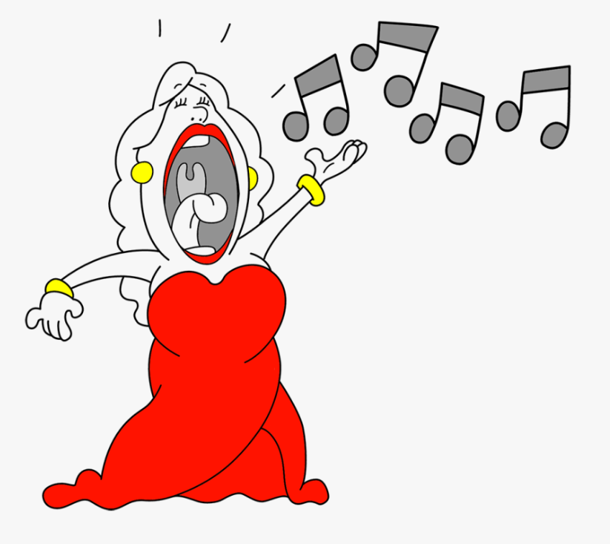

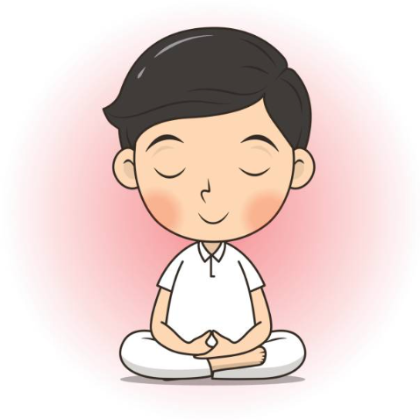
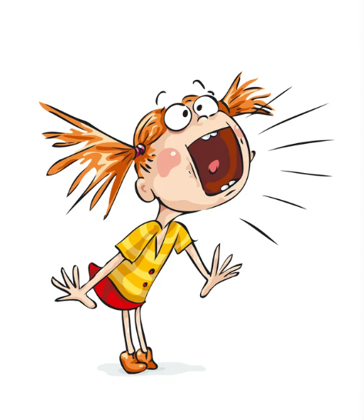
Healing & Energy
Some illustrations in human life experiences
Vibrating at High frequency Vibrating at Low frequency
Love & Light
Hard & Dark
High frequency – High vibration
Low frequency – Low vibration
Active & Dynamic
Tired & Depressed
High frequency – Calm vibration
Low frequency – Strong vibration
In alignment
Out of alignment

Slide 19
Healing & Energy
Energy is Light, it is Love, it is Life.
It is Vitality, Health, Happiness, Well-being, Joy, …
Increasing Quality of Energy
Light brightens – Love rises – Vitality increases
You’re feeling Happy and Healthy
Decreasing Quality of Energy
Light dims – Love drops – Vitality decreases
You’re feeling unhappy and unhealthy
Where there is Light, there’s Hope

Slide 20
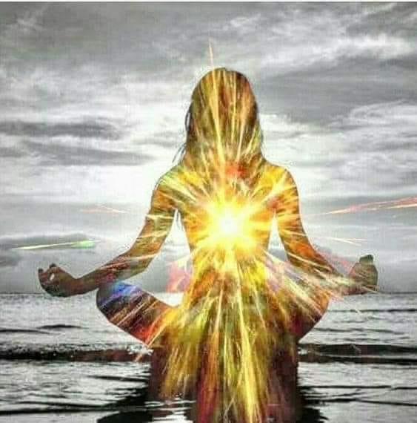
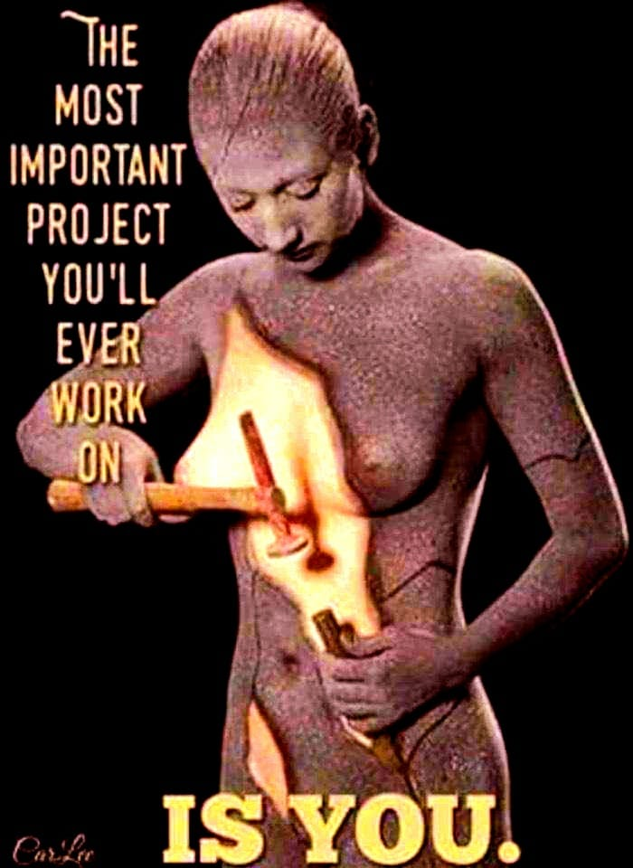
Healing & Energy
- Learning step 3 -
Allowing – Self-healing, an holistic approach
I am Energy, I am Light
I am my entire
Human experience
The Quality of my Energy
is my Responsibility
It is my Divine Work !

Slide 21
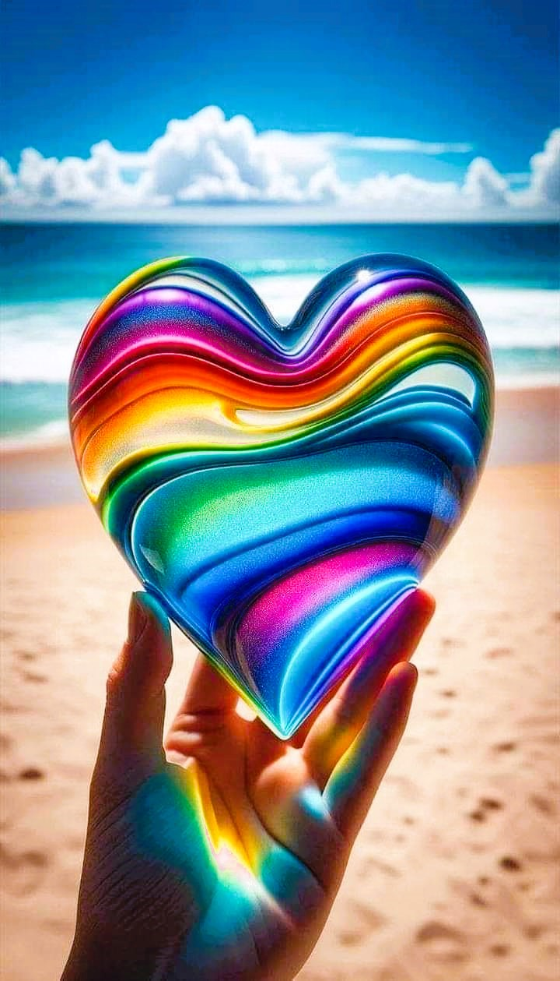
Healing & Energy
Healing is giving all attention to Self
  Reading and learning about cause and effect of energy dynamics – Your D O I N G
  Reversing the process of illness by adjusting unhealthy habits
  Dealing with old trauma-energies
  Opening up for guidance and help, allowing new information to change your conditioning and energy frequency
  Clearing & cleansing through
  learning will change Your B E I N G
  With Love and Attention for Self, actively working on creating New Desired Patterns

Slide 22
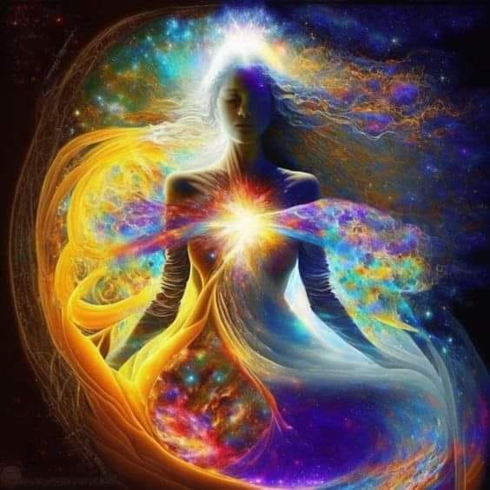
Form the teachings Learn to Realise
To Realise is
to Acknowledge what you are
and to learn how to Achieve Well-being
Healed and Evolved
I AM LIGHT, therefore I AM LOVE
My FIRST priority will ALWAYS
be Self so I can give what I AM !

Slide 23
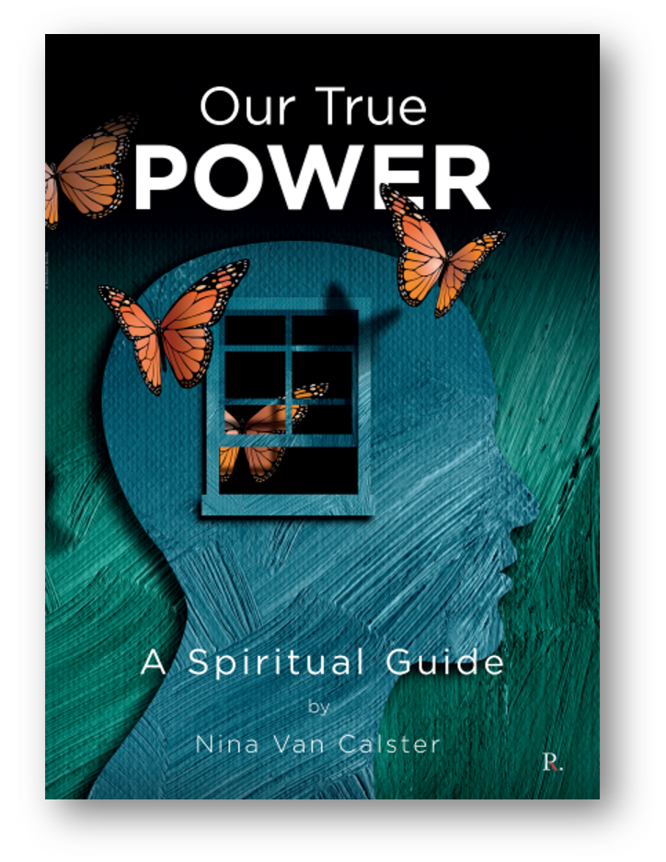
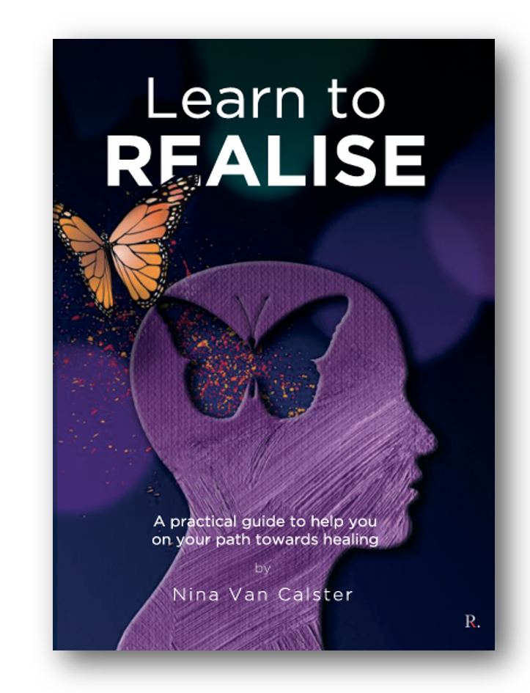
- To help you on your Healing Journey -
New release
€ 16,95 € 12,00
€ 18,95 € 15,00

Slide 24
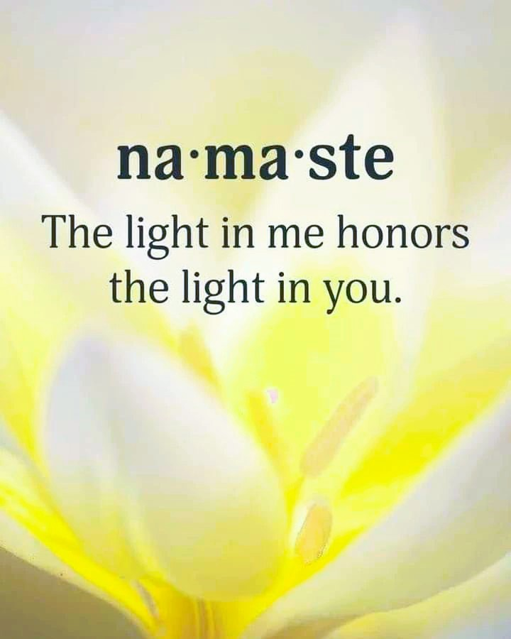
Healing & Energy
Final note
All information given in this teaching is based on research, study and personal experiences. Any student who wants to know more can ask the author/teacher for source references.
An infinite source of data is available to us all.
The Universal Consciousness.

